Slide 1

Database Systems
Chapter 14
Mr. Faizad Ullah
Lecturer Computer Science

Slide 2
CHAPTER 14
The Basics of Functional Dependencies and Normalization for Relational Databases

Slide 3
Normalization
Normalization is the process of reorganizing/restructuring data in a database with a series of so called normal-forms, so that it meets two basic requirements:
(1) There is no redundancy of data (all data is stored in only one place), and
(2) data dependencies are logical (all related data items are stored together).
Normalization is important for many reasons, but chiefly because it allows databases to take up as little disk space as possible, resulting in increased performance.

Slide 4
Informal Design Guidelines for Relational Databases
We first discuss informal guidelines for good relational design
Then we discuss formal concepts of functional dependencies and normal forms

Slide 5
Informal Design Guidelines for Relational Databases
What is relational database design?
The grouping of attributes to form "good" relation schemas
Two levels for measuring the “goodness” of relation schemas
The logical (conceptual) level, i.e., user view
The implementation (physical storage) level, i.e., tuples store in base relation.
Design is concerned mainly with base relations
What are the criteria for "good" base relations?

Slide 6
Informal Design Guidelines for Relational Databases
Semantics of the attributes must be clear in the schema
Reducing the redundant information
Reducing the NULL values
Disallowing the possibility of generating spurious tuples

Slide 7
1. Semantics of the Relational Attributes must be clear
GUIDELINE 1: Informally, each tuple in a relation should represent one entity or relationship instance. (Applies to individual relations and their attributes).
Attributes of different entities (EMPLOYEEs, DEPARTMENTs, PROJECTs) should not be mixed in the same relation
Only foreign keys should be used to refer to other entities
Entity and relationship attributes should be kept apart as much as possible.
Bottom Line: Design a schema that can be explained easily relation by relation. The semantics of attributes should be easy to interpret.

Slide 8
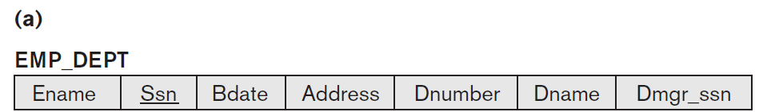
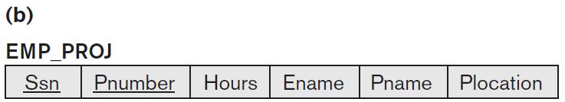
EXAMPLE

Slide 9
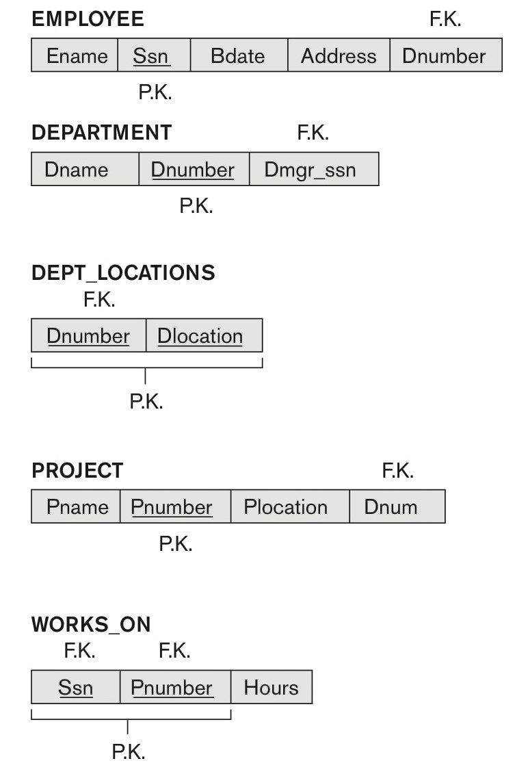
Company Database
Figure 14.1 A simplified COMPANY relational database schema.

Slide 10
Violating Guideline 1
By mixing attributes from distinct real-world entities

Slide 11
2. Redundant Information in Tuples and Update Anomalies
GUIDELINE 2:
Design a schema that does not suffer from the anomalies.
Note the anomalies and take them into account.

Slide 12
2. Redundant Information in Tuples and Update Anomalies
One goal of design schema is to minimize the storage space
By violating guideline 2:
Information is stored redundantly
Wastes storage
Causes problems such as
Insertion anomalies
Deletion anomalies
Modification anomalies

Slide 13
EXAMPLE OF AN INSERT ANOMALY
Consider the relation:
EMP_PROJ(Emp#, Proj#, Ename, Pname, No_hours)
Insert Anomaly:
Insert new employee in tuple
i) Add department or ii) NULL department
It is difficult to add department with zero (NULL) employees
Entity integrity

Slide 15
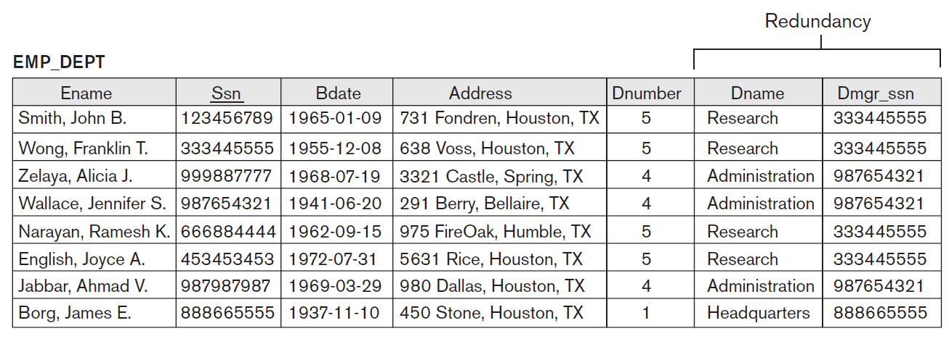
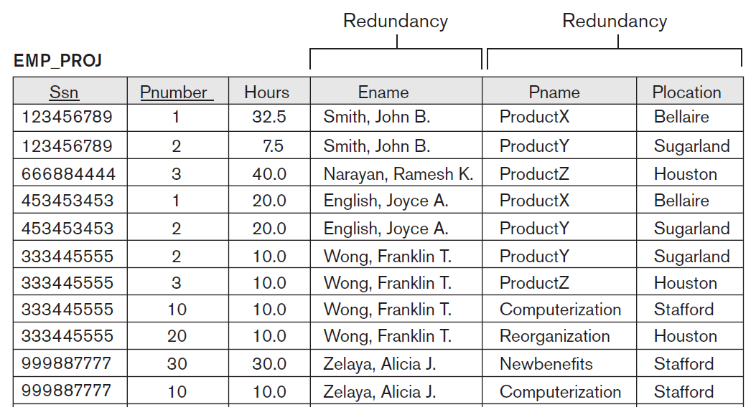

Slide 16
EXAMPLE OF A DELETE ANOMALY
Consider the relation:
EMP_PROJ(Emp#, Proj#, Ename, Pname, No_hours)
Delete Anomaly:
When a project is deleted, it will result in deleting all the employees who work on that project.
Alternately, if an employee is the sole employee on a project, deleting that employee would result in deleting the corresponding project.

Slide 18
EXAMPLE OF AN UPDATE ANOMALY
Consider the relation:
EMP_PROJ(Emp#, Proj#, Ename, Pname, No_hours)
Update Anomaly:
Changing the name of project number 1 from “Product X” to “Product Y” may cause this update to be made for all 100 employees working on project 1.

Slide 20
3. Null Values in Tuples
GUIDELINE 3:
Minimize the NULL values in tuples
Attributes that are NULL frequently could be placed in separate relations (with the primary key)

Slide 21
Reasons for Null
Attribute not applicable or invalid
(Visa_Status)
Attribute value unknown (may exist)
(Date_of_birth)
Value known to exist, but unavailable
(Home_Phone_Number)

Slide 22
4. Generation of Spurious Tuples – avoid at any cost
Design relation schemas so that they can be joined with equality conditions
No spurious tuples should be there.
Avoid relations that contain matching attributes that are not (foreign key, primary key) combinations
Bad designs for a relational database may result in erroneous results for certain JOIN operations
GUIDELINE 4:
No spurious tuples should be generated by doing a natural-join of any relations.

Slide 23
Functional Dependencies
A Functional Dependency (FD) is a constraint between attributes or two sets of attributes from the database (relation).

Slide 24
Functional Dependencies
Functional dependencies
Are used to specify formal measures of the "goodness" of relational designs
FDs are constraints that derived from the meaning and interrelationships of the data attributes
A set of attributes X functionally determines a set of attributes Y if the value of X determines a unique value for Y

Slide 25
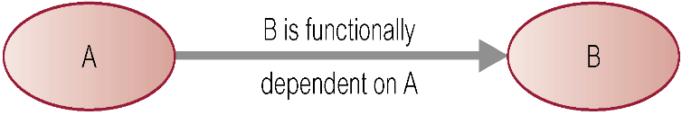
Defining Functional Dependencies
If A and B are attributes of relation R, B is functionally dependent on A (denoted A → B), if each value of A in R is associated with exactly one value of B in R.
X  Y holds if whenever two tuples have the same value for X, they must have the same value for Y
For any two tuples t1 and t2 in any relation instance r(R): If t1[X]=t2[X], then t1[Y]=t2[Y]
X  Y in R specifies a constraint on all relation instances r(R)
Written as X  Y; ( denoted by the arrow).
FDs are derived from the real-world constraints on the attributes

Slide 26
Examples of FD constraints (1)
Social security number determines employee name
SSN  ENAME
Project number determines project name and location
PNUMBER  {PNAME, PLOCATION}
Employee ssn and project number determines the hours per week that the employee works on the project
{SSN, PNUMBER}  HOURS

Slide 27
Examples of FD constraints (2)
An FD is a property of the attributes in the schema R
The constraint must hold on every relation instance r(R)
If K is a key of R, then K functionally determines all attributes in R
(since we never have two distinct tuples with t1[K]=t2[K])

Slide 28
Defining FDs from instances
Note that in order to define the FDs,
understand the meaning of the attributes
Given the instance (population) of a relation, all we can conclude is that an FD may exist between certain attributes.
What we can definitely conclude is – that certain FDs do not exist because there are tuples that show a violation of those dependencies.

Slide 29
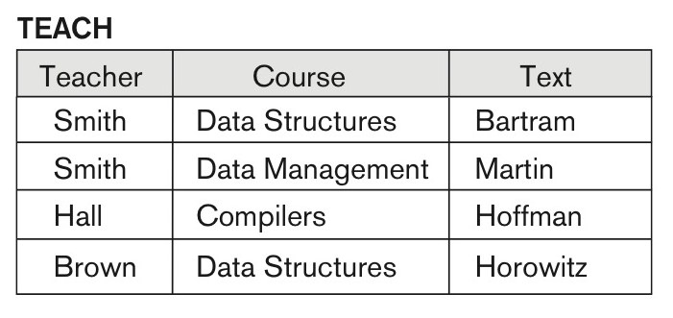
Example
Text → Course may exist.
However, the FDs Teacher → Course, Teacher → Text and Couse → Text are ruled out.

Slide 30
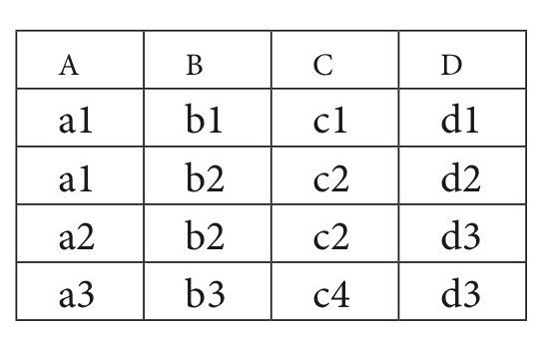
What FDs may exist?
A relation R(A, B, C, D) with its extension.

Slide 31
What FDs may exist?
FD holds
B -> C
C -> B
{A,B} -> C
{A,B} -> D
{A,C} -> B
{A,C} -> D
{A,D} -> B
{A,D} -> C
{B,D} -> A
{B,D} -> C
{C,D} -> A
{C,D} -> B
{A,B,C} -> D
{A,B,D} -> C
{B,C,D} -> A
FD not holds
A -> B
A -> C
A -> D
B -> A
B -> D
C -> A
C -> D
D -> A
D -> B
D -> C
{B,C} -> A
{B,C} -> D
Which FDs may exist in this relation?

Slide 32
Important Definitions
Determinant
Refers to the attribute, or group of attributes, on the left-hand side of the arrow of a functional dependency.
Full Functional dependency:
Indicates that if A and B are attributes of a relation, B is fully functionally dependent on A if B is functionally dependent on A, but not on any proper subset of A.
{StaffNo, StaffName} → BranchNo
StaffNo → BranchNo
Transitive Dependency
A condition where A, B, and C are attributes of a relation such that if A → B and B → C, then C is transitively dependent on A via B.

Slide 33
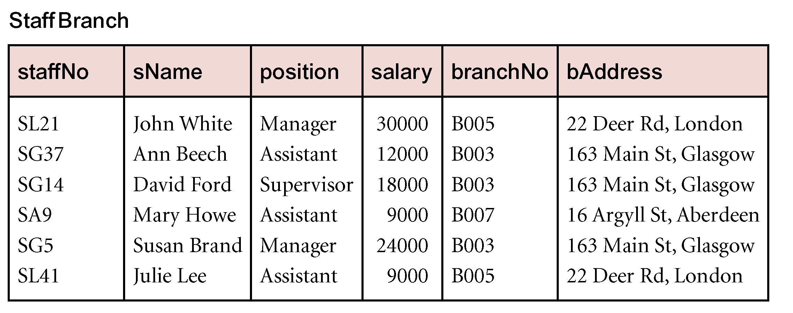
Example Transitive Dependency
Consider functional dependencies in the StaffBranch relation
staffNo → sName, position, salary, branchNo, bAddress
branchNo → bAddress
Transitive dependency:
staffNo → branchNo
branchNo → bAddress exists on staffNo via branchNo

Slide 34
Normalization of Relations
Normalization:
The process of decomposing unsatisfactory "bad" relations by breaking up their attributes into smaller relations
Normal form:
Condition using keys and FDs of a relation to certify whether a relation schema is in a particular normal form

Slide 35
Normalization of Relations
2NF, 3NF,BCNF
based on keys and FDs of a relation schema
4NF
based on keys, multi-valued dependencies : MVDs;
5NF
based on keys, join dependencies : JDs

Slide 36
Normalization of Data
Analyzing the relation:
FDs
Primary Keys
Minimizing redundancy
Minimizing anomalies
Insertion
Deletion
Update

Slide 37
Practical Use of Normal Forms
Normalization
High quality design
Meet the desirable properties
Usually up to 3NF and BCNF, 4NF rarely used in practice
Denormalization:
The process of storing the join of higher normal form relations as a base relation—which is in a lower normal form

Slide 38
Keys
Superkey
Key
Primary Key
Secondary Key
Prime Attribute
Nonprime Attribute

Slide 39
Definitions of Keys and Attributes Participating in Keys (1)
A superkey of a relation schema R = {A1, A2, ...., An} is a set of attributes S subset-of R with the property that no two tuples t1 and t2 in any legal relation state r of R will have t1[S] = t2[S]
A key K is a superkey with the additional property that removal of any attribute from K will cause K not to be a superkey any more.
Key K has to be minimal

Slide 40
Definitions of Keys and Attributes Participating in Keys (2)
If a relation schema has more than one key, each is called a candidate key.
One of the candidate keys is arbitrarily designated to be the primary key, and the others are called secondary keys.
A Prime attribute must be a member of some candidate key
A Nonprime attribute is not a prime attribute—that is, it is not a member of any candidate key.

Slide 41
First Normal Form
Disallows
composite attributes
multivalued attributes (no repeating group)
The only attribute values permitted by 1NF are single atomic (or indivisible) values.

Slide 42
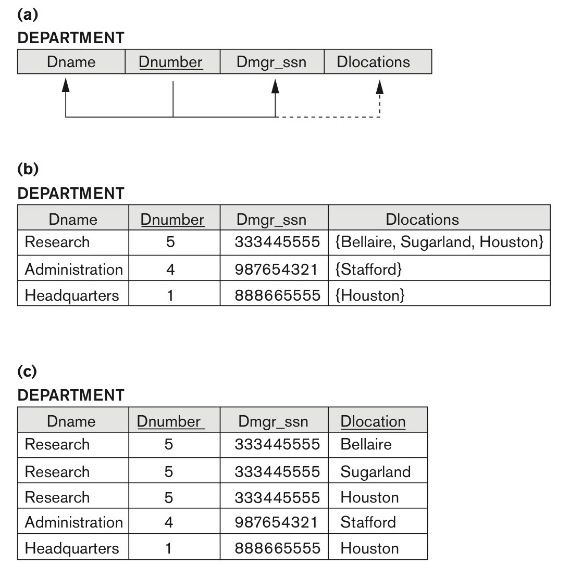
Figure 14.9
Normalization into 1NF. (a) A relation schema that is not in 1NF. (b) Sample state of relation DEPARTMENT. (c) 1NF version of the same relation with redundancy.

Slide 43
SOLUTIONS
Remove the attribute Dlocations
Expand the Key
Replace the attribute (Dlocations) by three atomic attributes: Dlocation1, Dlocation2, and Dlocation3.

Slide 44
SOLUTIONS
The right way to deal with the two multivalued attributes is to decompose it into two separate relations.

Slide 45
Second Normal Form
Uses the concepts of FDs, primary key
Definitions
Prime attribute: An attribute that is member of the primary key K
Full functional dependency: a FD Y -> Z where removal of any attribute from Y means the FD does not hold any more
Examples:
{SSN, PNUMBER} -> HOURS is a full FD since neither
SSN -> HOURS nor
PNUMBER -> HOURS hold
{SSN, PNUMBER} -> ENAME is not a full FD (it is called a partial dependency ) since SSN -> ENAME also holds

Slide 46
Second Normal Form
A relation schema R is in second normal form (2NF) if every non-prime attribute A in R is fully functionally dependent on the primary key
R can be decomposed into 2NF relations via the process of 2NF normalization or “second normalization”

Slide 47
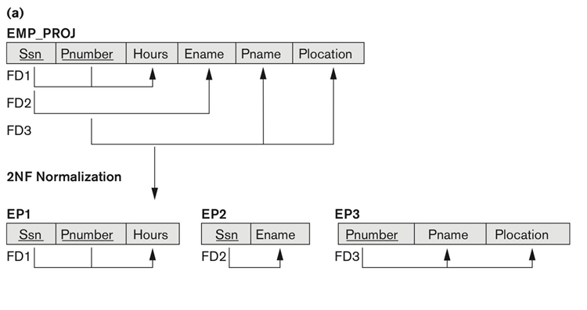
Figure 14.11
Normalizing into 2NF

Slide 48
Third Normal Form
Definition:
Transitive functional dependency: a FD X -> Z that can be derived from two FDs X -> Y and Y -> Z
Examples:
SSN -> DMGRSSN is a transitive FD
Since SSN -> DNUMBER and DNUMBER -> DMGRSSN hold
SSN -> ENAME is non-transitive
Since there is no set of attributes X where SSN -> X and X -> ENAME

Slide 49
Third Normal Form
A relation schema R is in third normal form (3NF) if it is in 2NF and no non-prime attribute A in R is transitively dependent on the primary key
R can be decomposed into 3NF relations via the process of 3NF normalization
NOTE:
In X -> Y and Y -> Z, with X as the primary key, we consider this a problem only if Y is not a candidate key.
When Y is a candidate key, there is no problem with the transitive dependency .
E.g., Consider EMP (SSN, Emp#, Salary ).
Here, SSN -> Emp# -> Salary and Emp# is a candidate key.

Slide 50
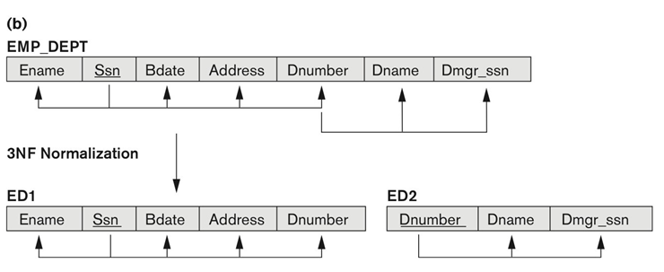
Figure 14.11
Normalizing into 2NF and 3NF. (b) Normalizing EMP_DEPT into 3NF relations.

Slide 51
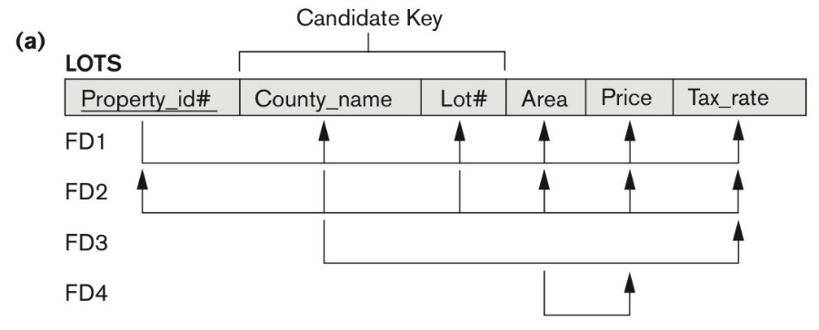
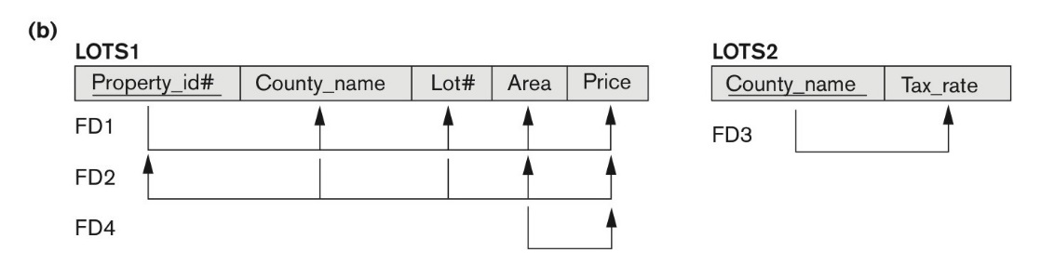
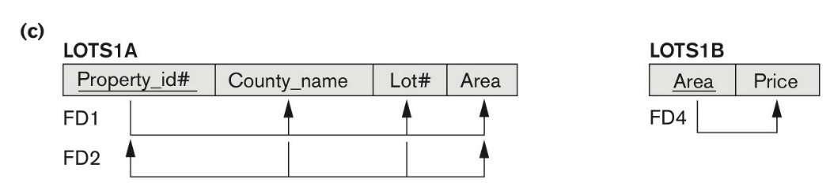
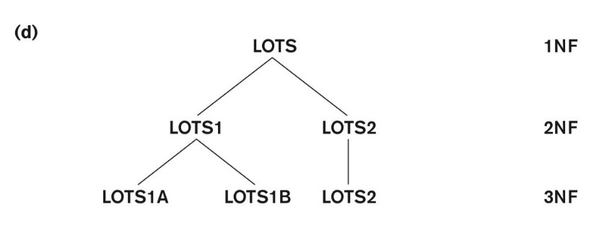
Tax_rate is partially dependent on the candidate key
Price is transitively dependent on each of the candidate keys via non-prime attribute area
Figure 14.12 Normalization into 2NF and 3NF.
(a) The LOTS relation with its functional dependencies FD1 through FD4.
(b) Decomposing into the 2NF relations LOTS1 and LOTS2.
(c) Decomposing LOTS1 into the 3NF relations LOTS1A and LOTS1B.
(d) Progressive normalization of LOTS into a 3NF design.

Slide 52
Normal Forms Defined Informally
1st normal form
All attributes depend on the key
2nd normal form
All attributes depend on the whole key
3rd normal form
All attributes depend on nothing but the key

Slide 53
3NF
No Non-Prime attribute is transitively dependent on any candidate key
BCNF
Every determinant is a candidate key

Slide 54
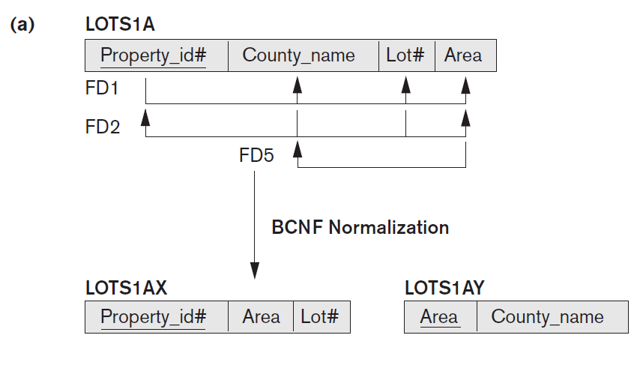
Suppose that we have thousands of lots in the relation, but the lots are from only two counties: DeKalb and Fulton.
Suppose also that lot sizes in DeKalb County are only
0.5, 0.6, 0.7, 0.8, 0.9, and 1.0 acres, whereas
lot sizes in Fulton County are restricted to
1.1, 1.2, … , 1.9, and 2.0 acres.
In such a situation we would have the additional functional dependency FD5: Area → County_name.

Slide 55
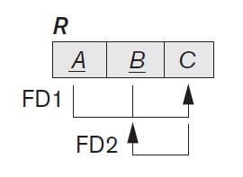
The table above is in 3NF but not in BCNF, because of the C → B

Slide 56
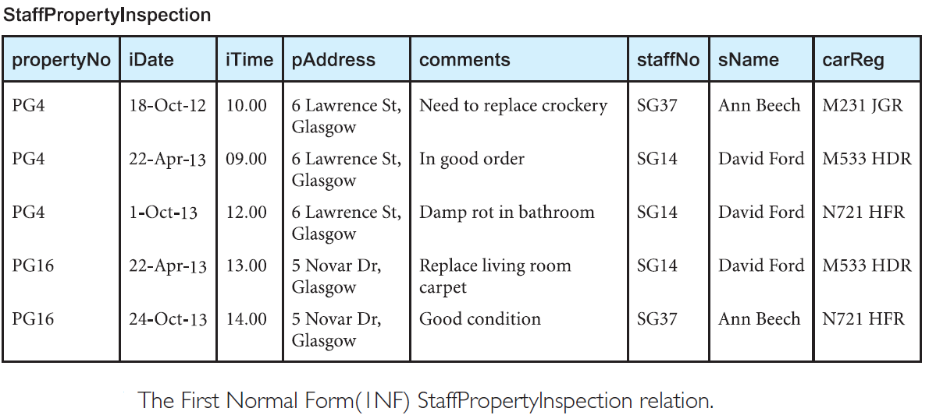

Slide 57
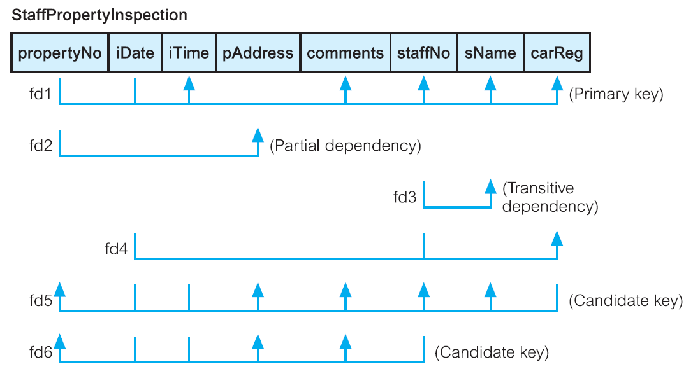
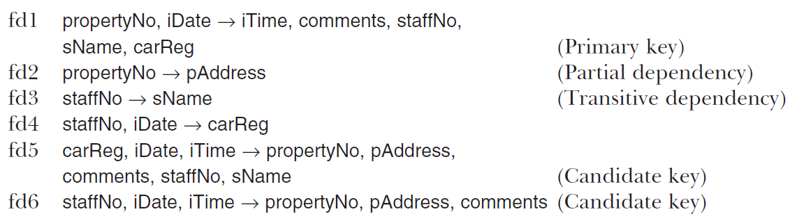

Slide 58
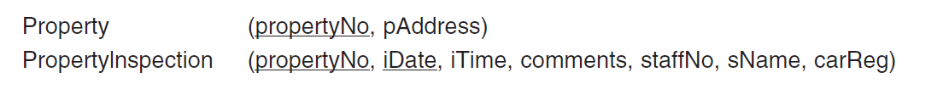
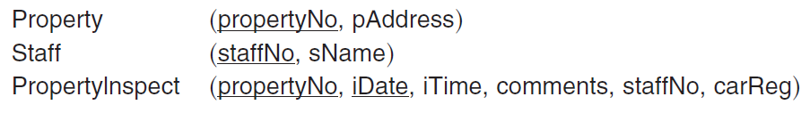

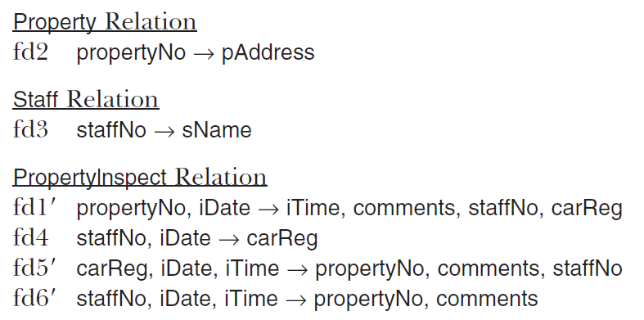
Second Normal Form (2NF)
Third Normal Form (3NF)
Boyce–Codd Normal Form (BCNF)

Slide 59
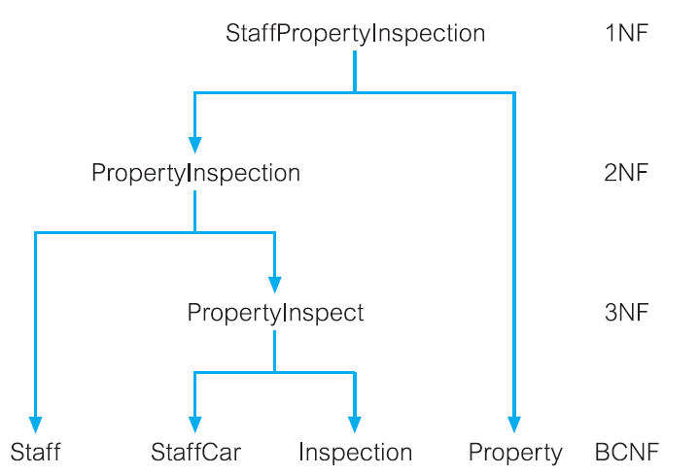

Slide 60
General Normal Form Definitions (For Multiple Keys)
The above definitions consider the primary key only
The following more general definitions take into account relations with multiple candidate keys
Any attribute involved in a candidate key is a prime attribute
All other attributes are called non-prime attributes.

Slide 61
General Definition of 2NF (For Multiple Candidate Keys)
A relation schema R is in second normal form (2NF) if every non-prime attribute A in R is fully functionally dependent on every key of R
In Figure 14.12 the FD
County_name → Tax_rate violates 2NF.
So second normalization converts LOTS into
LOTS1 (Property_id#, County_name, Lot#, Area, Price)
LOTS2 ( County_name, Tax_rate)

Slide 62
General Definition of Third Normal Form
Definition:
Superkey of relation schema R - a set of attributes S of R that contains a key of R
A relation schema R is in third normal form (3NF) if whenever a FD X → A holds in R, then either:
(a) X is a superkey of R, or
(b) A is a prime attribute of R
LOTS1 relation violates 3NF because
Area → Price ; and Area is not a superkey in LOTS1. (see Figure 14.12).

Slide 63
Interpreting the General Definition of Third Normal Form
Consider the 2 conditions in the Definition of 3NF:
A relation schema R is in third normal form (3NF) if whenever a FD X → A holds in R, then either:
(a) X is a superkey of R, or
(b) A is a prime attribute of R
Condition (a) catches two types of violations :
- one where a prime attribute functionally determines a non-prime attribute. This catches 2NF violations due to non-full functional dependencies.
-second, where a non-prime attribute functionally determines a non-prime attribute. This catches 3NF violations due to a transitive dependency.

Slide 64
Interpreting the General Definition of Third Normal Form
ALTERNATIVE DEFINITION of 3NF: We can restate the definition as:
A relation schema R is in third normal form (3NF) if every non-prime attribute in R meets both of these conditions:
It is fully functionally dependent on every key of R
It is non-transitively dependent on every key of R
Note that stated this way, a relation in 3NF also meets the requirements for 2NF.
The condition (b) from the last slide takes care of the dependencies that “slip through” (are allowable to) 3NF but are “caught by” BCNF which we discuss next.

Slide 65
3NF
No Non-Prime attribute is transitively dependent on any candidate key
BCNF
Every determinant is a candidate key

Slide 66
BCNF is the advance version of 3NF. It is stricter than 3NF.
A table is in BCNF if every functional dependency X → Y, X is the super key of the table.
For BCNF, the table should be in 3NF, and for every FD, LHS is super key.

Slide 67
BCNF (Boyce-Codd Normal Form)
A relation schema R is in Boyce-Codd Normal Form (BCNF) if whenever an FD X → A holds in R, then X is a superkey of R
Each normal form is strictly stronger than the previous one
Every 2NF relation is in 1NF
Every 3NF relation is in 2NF
Every BCNF relation is in 3NF
There exist relations that are in 3NF but not in BCNF
Hence BCNF is considered a stronger form of 3NF
The goal is to have each relation in BCNF (or 3NF)

Slide 68

A relation TEACH that is in 3NF but not in BCNF
Figure 14.14
A relation TEACH that is in 3NF but not BCNF.

Slide 69
Achieving the BCNF by Decomposition
Two FDs exist in the relation TEACH:
fd1: { student, course} -> instructor
fd2: instructor -> course
{student, course} is a candidate key for this relation and that the dependencies shown follow the pattern in Figure 14.13 (b).
So this relation is in 3NF but not in BCNF
A relation NOT in BCNF should be decomposed so as to meet this property, while possibly forgoing the preservation of all functional dependencies in the decomposed relations.

Slide 70
Achieving the BCNF by Decomposition
Three possible decompositions for relation TEACH
D1: {student, instructor} and {student, course}
D2: {course, instructor } and {course, student}
D3: {instructor, course } and {instructor, student} ✓
All three decompositions will lose FD1
FD1: { student, course} -> instructor
We have to settle for sacrificing the functional dependency preservation.
But we cannot sacrifice the non-additivity property after decomposition.

Slide 71
Test for checking non-additivity of Binary Relational Decompositions
Testing Binary Decompositions for Lossless Join (Non-additive Join) Property
Binary Decomposition: Decomposition of a relation R into two relations.
PROPERTY NJB (non-additive join test for binary decompositions)

Slide 72
Multivalued Dependencies and Fourth Normal Form
Definition:
Multivalued dependency occurs when two attributes in a relation/table are independent of each other but, both depend on a third attribute.
Consist at least three attributes

Slide 73
Multivalued Dependencies and Fourth Normal Form
Definition:
A relation schema R is in 4NF with respect to a set of dependencies F (that includes functional dependencies and multivalued dependencies) if, for every nontrivial multivalued dependency X —>> Y in F⁺, X is a superkey for R.
Note: F⁺ is the (complete) set of all dependencies (functional or multivalued) that will hold in every relation state r of R that satisfies F. It is also called the closure of F.
A relation will be in 4NF if it is in Boyce-Codd normal form and has no multi-valued dependency.

Slide 74
Bike_Model | MAN_Year | Colour
M2011 | 2008 | White
M2001 | 2008 | Black
M3001 | 2013 | White
M3001 | 2013 | White
M4006 | 2017 | Black
M4006 | 2017 | Black

Slide 75
Join Dependencies and Fifth Normal Form
Definition:
A join dependency (JD), denoted by JD(R₁, R₂, ..., R_{n}), specified on relation schema R, specifies a constraint on the states r of R.
A join dependency JD(R₁, R₂, ..., R_{n}), specified on relation schema R, is a trivial JD if one of the relation schemas R_{i} in JD(R₁, R₂, ..., R_{n}) is equal to R.

Slide 76
Join Dependencies and Fifth Normal Form
A relation is in 5NF if it is in 4NF and not contains any join dependency and joining should be lossless.

Slide 77
Join Dependencies and Fifth Normal Form
Discovering join dependencies in practical databases with hundreds of relations is next to impossible. Therefore, 5NF is rarely used in practice.

